Slide 1

Getting started with MonarQ (MNQ-101)
Juliette Geoffrion and Kim Renaud - February 25 2025

Slide 2




















Members and Partners
Connectivity Partners
Financial Partners

Slide 3


Zoom
If you experience technical problems, mention them in the Chat. An assistant will help you.
If you have a question related to the course content, use the Q&A.
You can also raise your hand and activate your microphone to ask a question.

Slide 4
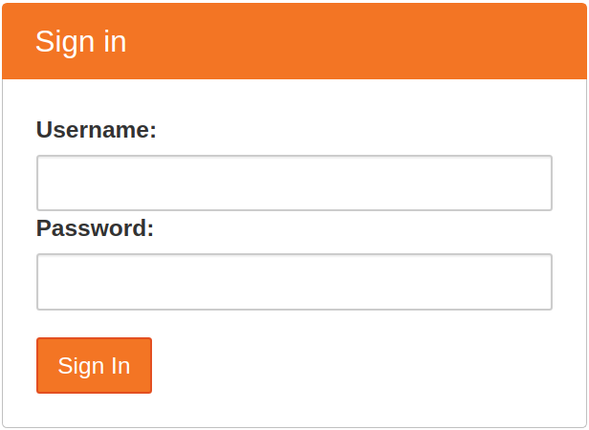
Connect to JupyterLab
https://mnq101.calculquebec.cloud/
userXX où XX = [101-199]
See username sheet

Slide 5

Video Recording
For whom and why?
For registered participants to refer to the recording
For Calcul Québec staff to improve the workshop
For how long?
The video will be stored and available for 6 months.
Prefer not to be identified?
Mute yourself and only ask your questions in the chat

Slide 6
Getting started with MonarQ
(MNQ-101)
Calcul Québec and MonarQ
Quantum information fundamentals overview
  Notebook 1 (optional) : Build a quantum simulator
Quantum computing in NISQ era
  Capabilities and limitations of MonarQ
  Literature overview
How do you program a quantum computer?
  Notebook 2 : PennyLane basics
Case study (time permitting) :
  Notebook 3 : Double slit experiment
Questions

Slide 7

Learning goals
Review core concepts in quantum information
Core concepts : Qubits, Dirac notation, superposition, quantum operations, Bloch sphere, measurement
Explain the challenges and limitations of NISQ era quantum computing
Core concepts : NISQ, FTQC, MonarQ performances and constraints
Write quantum circuits in PennyLane
Core concepts : quantum circuits, devices, qnodes, quantum gates and measurements

Slide 8

Calcul Québec
A few words about who we are

Slide 9









Our services
Cloud
computing
Personalized support
Computing clusters
Quantum
computing
Interactive
Computing
(notebooks)
Training Workshops
Data Storage
Documentation
Notes:
Déploiement de systèmes
Virtualisation et infonuagique
Calcul interactif (notebooks)
Stockage et partage de données « actives »
Aide à la détermination des besoins
Initiation aux environnements calcul informatique de pointe (CIP)
Configuration / utilisation de logiciels commerciaux
Optimisation de code et flots de travail
Développement logiciel
Visualisation
Documentation

Slide 10


Calcul Québec’s Infrastructure
Classical Computing clusters
Béluga and Narval
140,000 CPU
1,300 GPU
Computing clusters
Universal quantum computer
MonarQ
24 superconducting qubits
Quantum
computing
Notes:
Computing clusters (queue mode)
Béluga, Narval
→ 140,000 CPU, 1,300 GPU
Fully configured software environment
Cloud clusters
Configurable computing instances
Permanent instances
Interactive computing (notebooks)
Active data storage
home - scratch - project - ribbon
sharing via national accounts
→ 80 PB
MonarQ
superconducting quantum computer
→ 24 qubits

Slide 11
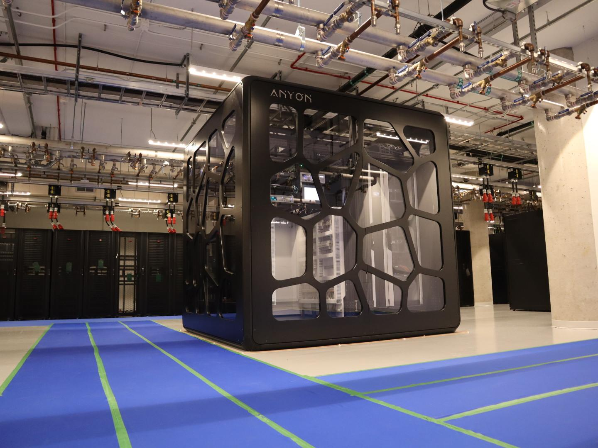

Slide 12
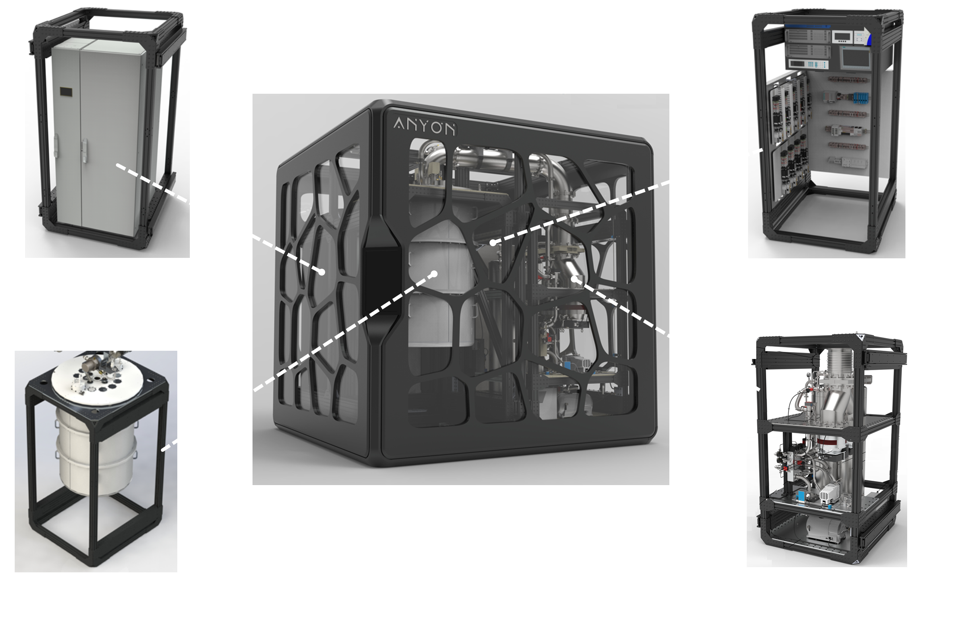
MonarQ
© 2024 Anyon Systems Inc. All rights reserved.

Slide 13
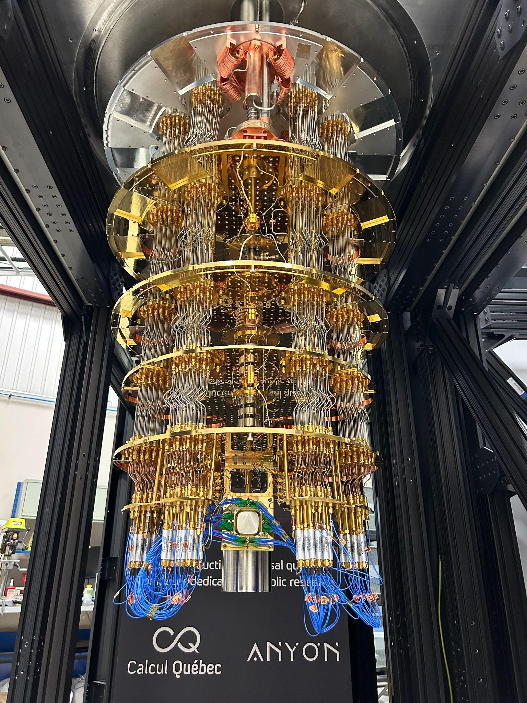
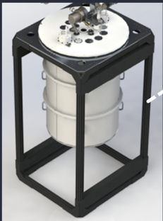
Cryostat Module (dilution refrigerator)
QPU is kept around 15 mK

Slide 14
Chapter 1 : quantum information fundamentals

Slide 15



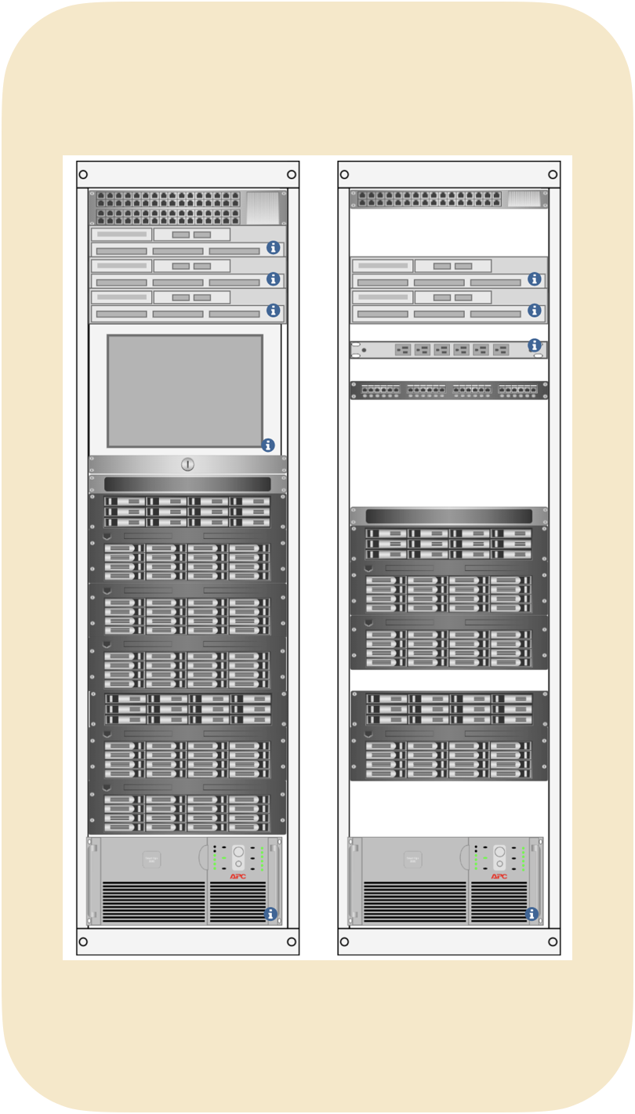
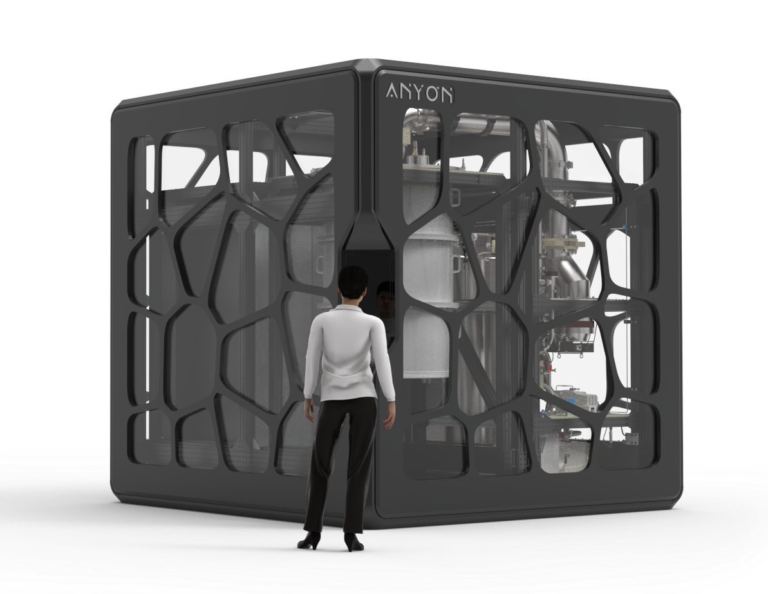
Overview
Quantum computing
Uses quantum bits or qubits
Superposition, entanglement and interference
Probabilistic computation
MonarQ
Classical computing
Uses binary states or bits (0 and 1)
Deterministic computation
Laptops, phones, computing clusters etc

Slide 16
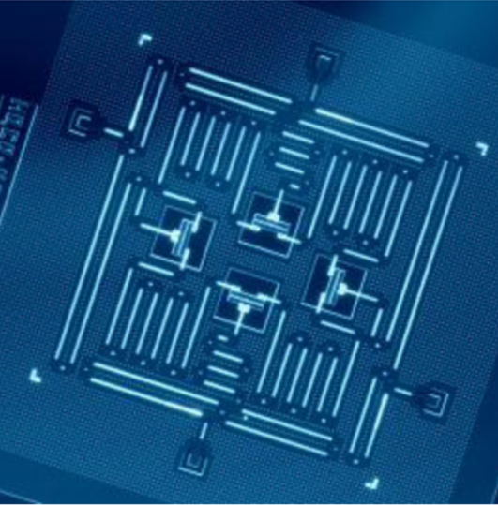
Qubits
Fundamental element of computation exhibiting the properties of quantum mechanics.
The Boolean states 0 and 1 are represented by a pair of normalised and orthogonal quantum states and
In practice, a qubit is typically a microscopic system such as an atom, an electron, a spin or a polarised photon.
MonarQ’s qubits are transmons made from superconducting material operating at extremely low temperatures and manipulated by microwave pulses.
https://www.nature.com/articles/s41534-016-0004-0

Slide 17

Coding break
Notebook 1 :
Building a quantum simulator

Slide 18
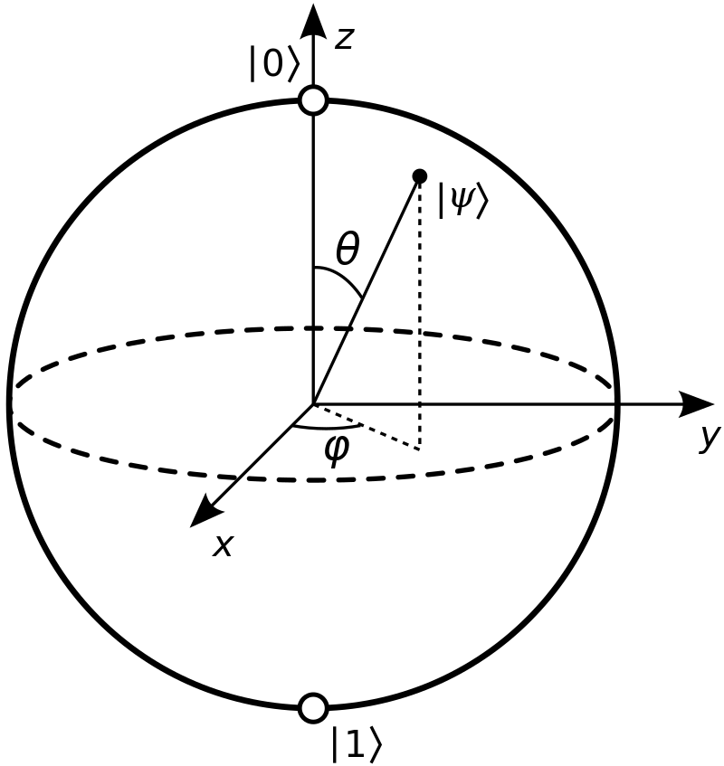





Notebook 1 : Cheat Sheet
Qubits can be in a superposition state
  with
  Represented by a vector in a complex vector space
Dirac notation
  A ket is a column vector and its associated bra is a row vector obtained by taking the complex conjugate transpose.
Bloch sphere
  Visual representation of a qubit as a vector on a sphere with and as coordinates for the state :
Quantum gates are unitary matrices and act on qubits like rotations on the Bloch sphere.
A quantum circuit is a sequence of unitary transformations (gates) applied to an initial state.
  Measurement gives probabilistic results based on the final state of the qubit

Slide 19
Chapter 2 : Quantum computing in the NISQ era

Slide 20
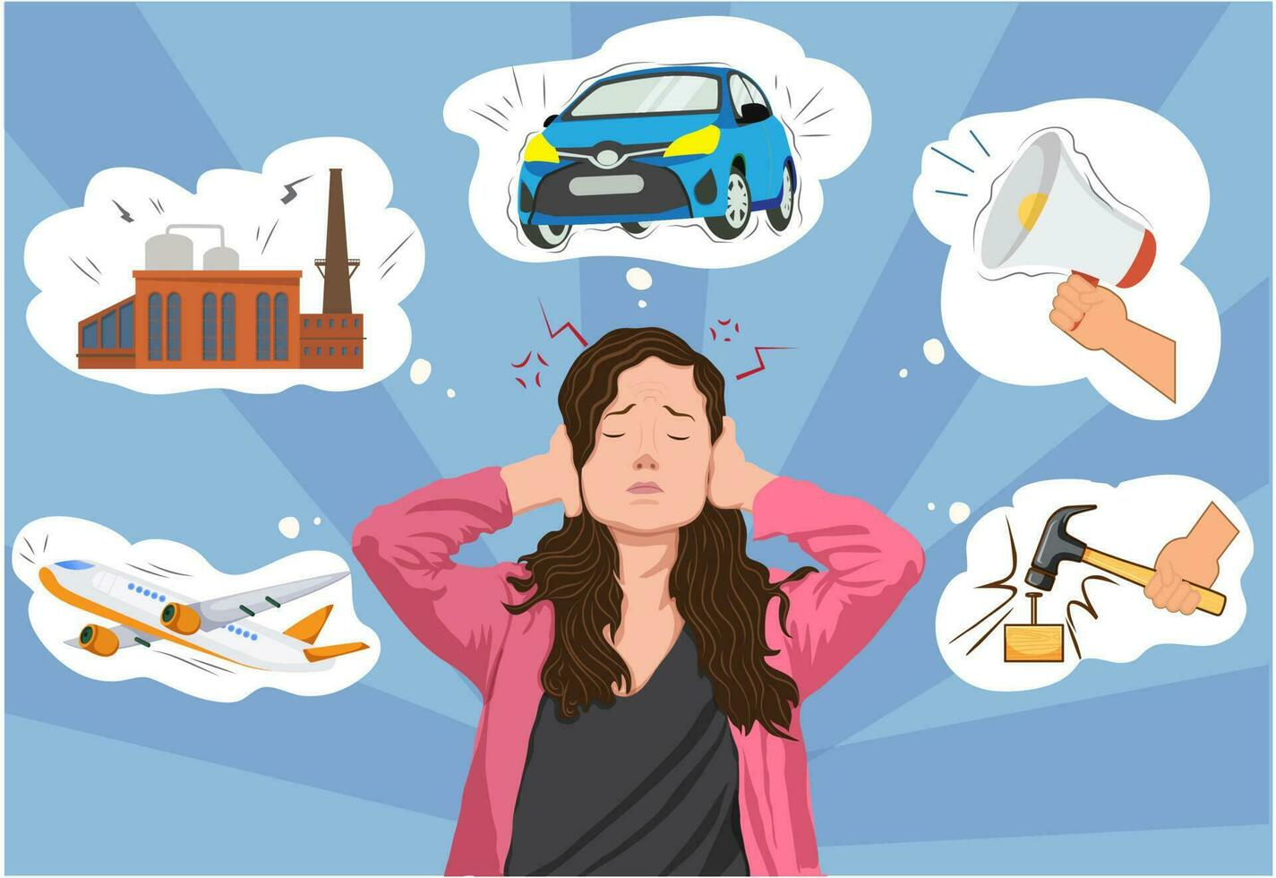
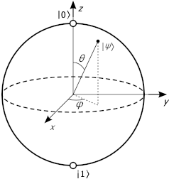
Quantum computers are noisy
Qubits are highly susceptible to quantum noise
Circuit depth (number of circuit layers) makes runtime longer, and thus adds and propagates noise
Circuits must be as short as possible
Circuit must be executable on a given machine
https://www.vecteezy.com/vector-art/23929483-noise-pollution-harmful-sounds-causing-disturbances-affecting-health-and-environment

Slide 21
NISQ Era
Noisy Intermediate
Scale Quantum Computers
Currently available quantum processors
High Noise levels
Limits qubit counts
Limits circuit depth
MonarQ
Number of qubits | 24 qubits
Max depth | ~350
Notes:
https://pennylane.ai/qml/whatisqml/

Slide 22
MonarQ performance metric
Metric | Median value *
T₁ | 9.4 µs
T_{2,Ramsey} | 1.3 µs
T_{2,Echo} | 3.3 µs
Single-qubit gate fidelity | 99.75%
CZ gate fidelity | 96.2%
*Based on data from Dec. 4, 2024 to Dec. 18, 2024

Slide 23
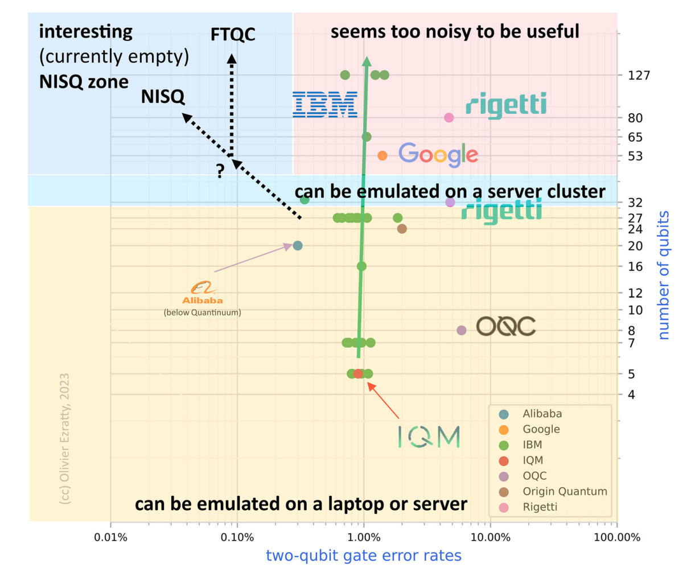
Towards FTQC
Fault
Tolerant
Quantum Computers
Long term goal of quantum computing
Error-corrected quantum computers
Larger number of qubits needed to make logical qubits (1000:1)
Logical qubit : robust to errors (as opposed to a physical qubit)
Increased circuit depth
Notes:
https://pennylane.ai/qml/whatisqml/

Slide 24
Source : Eur. Phys. J. A (2023) 59:94 https://doi.org/10.1140/epja/s10050-023-01006-7

Slide 25

Common misconception
Misconception : All problems benefit from quantum speedup.
Reality : Quantum speedup depends on the problem. Many tasks see no advantage, and the overhead of quantum state preparation and error mitigation can outweigh the benefits on current devices.

Slide 26
When should I use a quantum computer?
Laptop will suffice
NISQ friendly problems
Fault-tolerant QC required
Arithmetic
Checking emails
Chemistry
Machine learning
Optimization
… and other fields of research
Shor’s algorithm
Quantum fourier transform
Grover’s algorithm
Slide adapted from https://learning.quantum.ibm.com/course/quantum-computing-in-practice/what-problems-are-quantum-computers-good-for

Slide 27
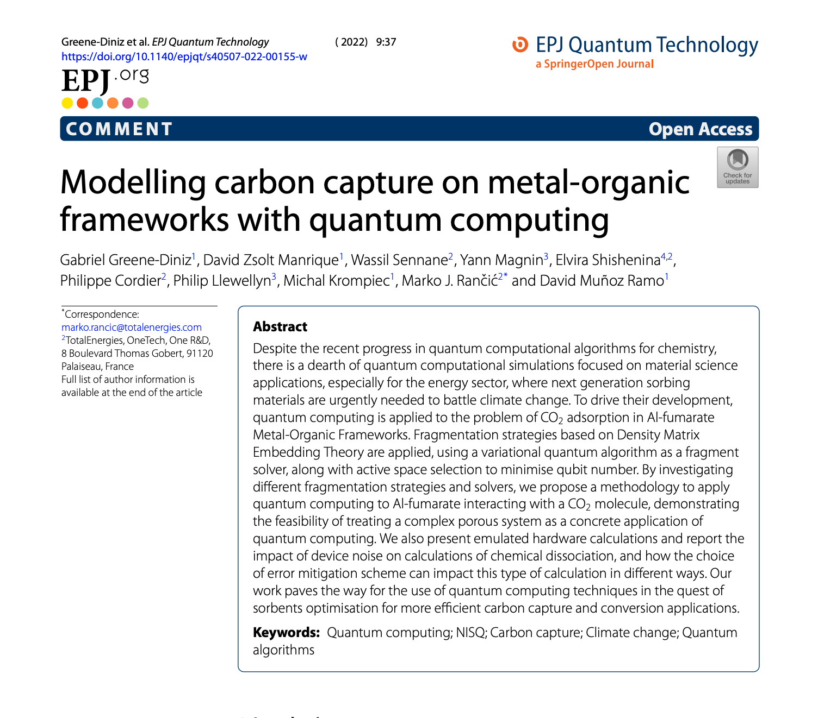
Chemistry
NISQ Case Study
Source : https://epjquantumtechnology.springeropen.com/articles/10.1140/epjqt/s40507-022-00155-w
Notes:
Formation de CQ
Etes vous intéressé à utiliser monarQ dans votre cours (can we do this?)

Slide 28
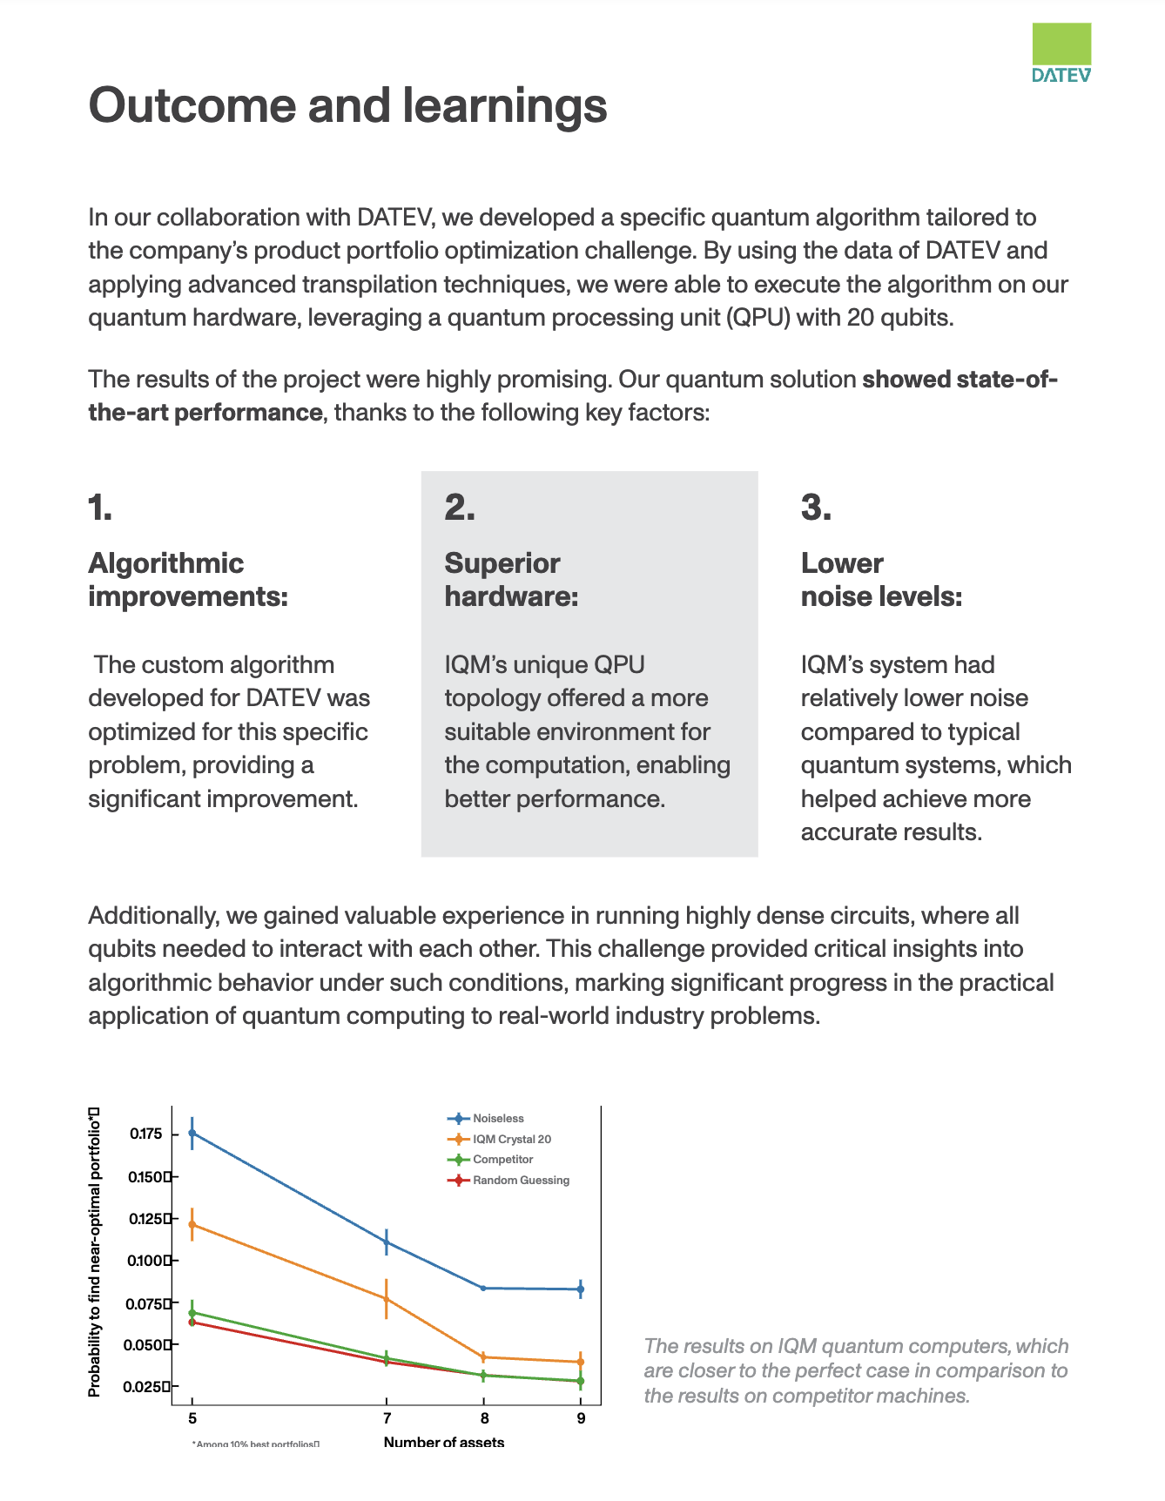
Optimization
NISQ Case Study
IQM and DATEV advance quantum solutions for portfolio optimization
Source : https://www.meetiqm.com/lp/the-future-of-portfolio-optimization-is-in-quantum
Notes:
Formation de CQ
Etes vous intéressé à utiliser monarQ dans votre cours (can we do this?)

Slide 29
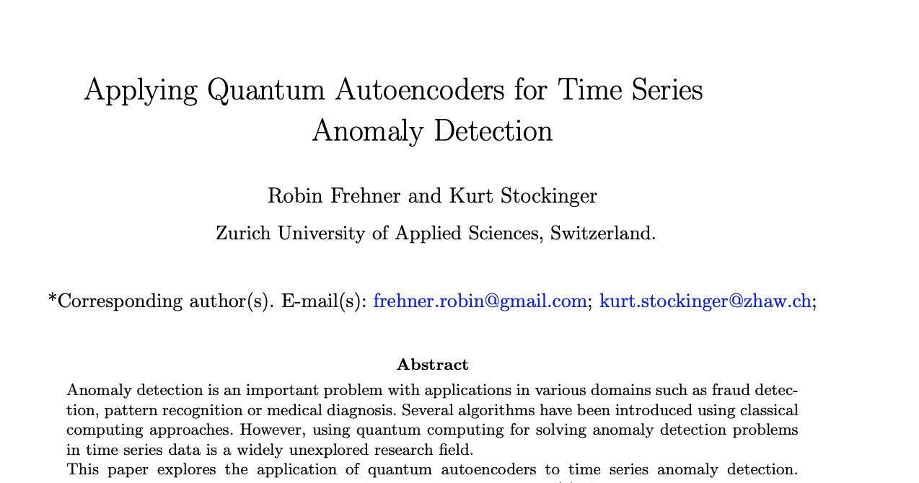
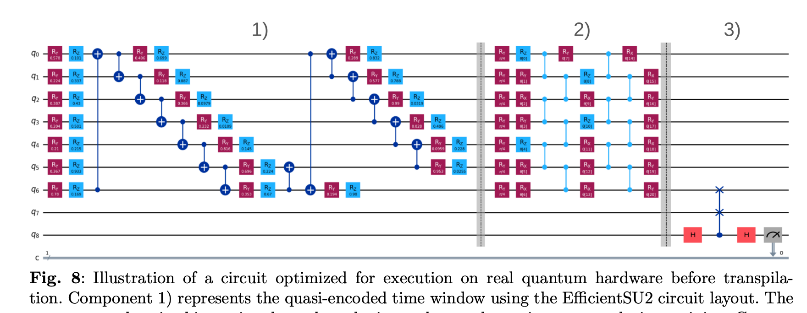
Machine Learning
NISQ Case Study
Source : https://arxiv.org/abs/2410.04154
Notes:
Formation de CQ
Etes vous intéressé à utiliser monarQ dans votre cours (can we do this?)

Slide 30
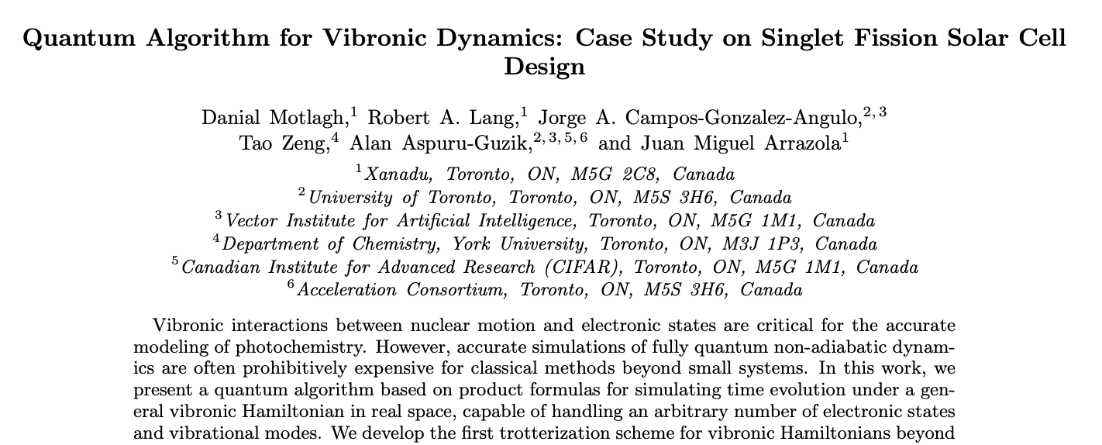
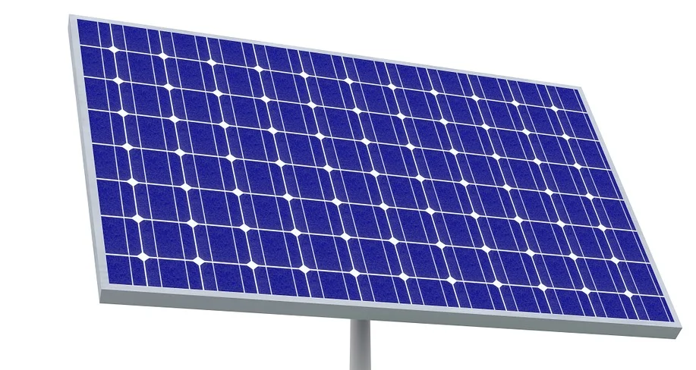
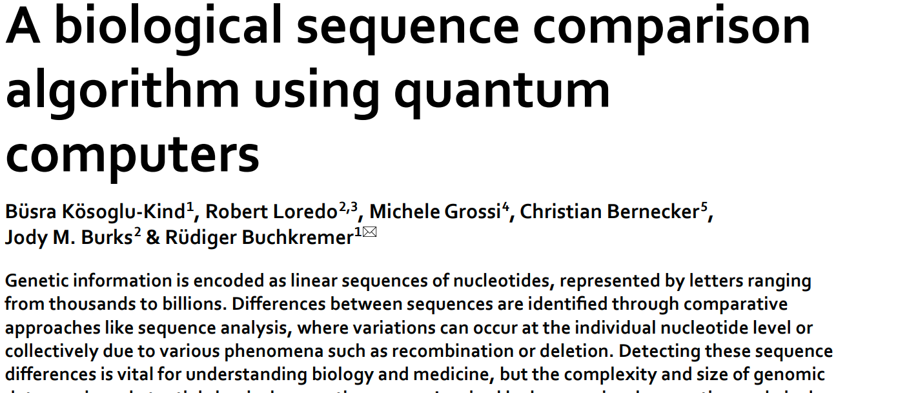

and other active fields of research
NISQ Case Study
Material science
Biology
Notes:
Formation de CQ
Etes vous intéressé à utiliser monarQ dans votre cours (can we do this?)

Slide 31
Chapter 3 : How do you program a quantum computer?

Slide 32
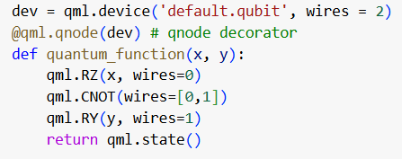
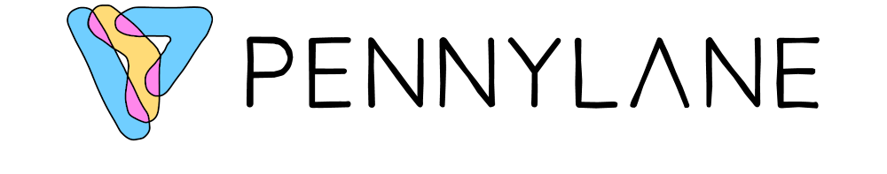
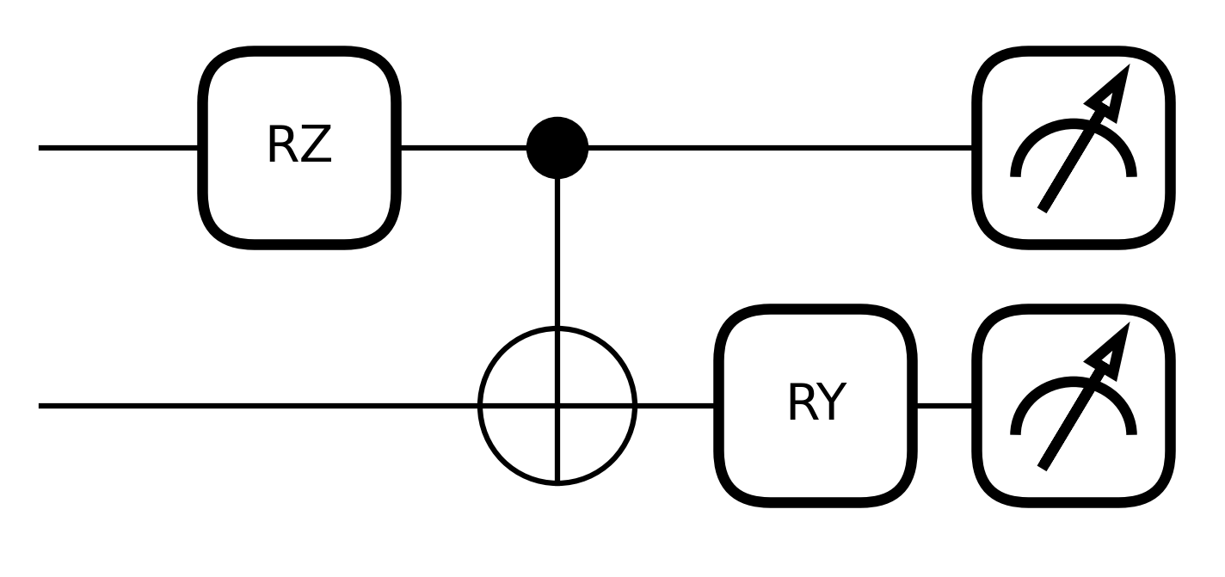
Quantum circuits

Slide 33
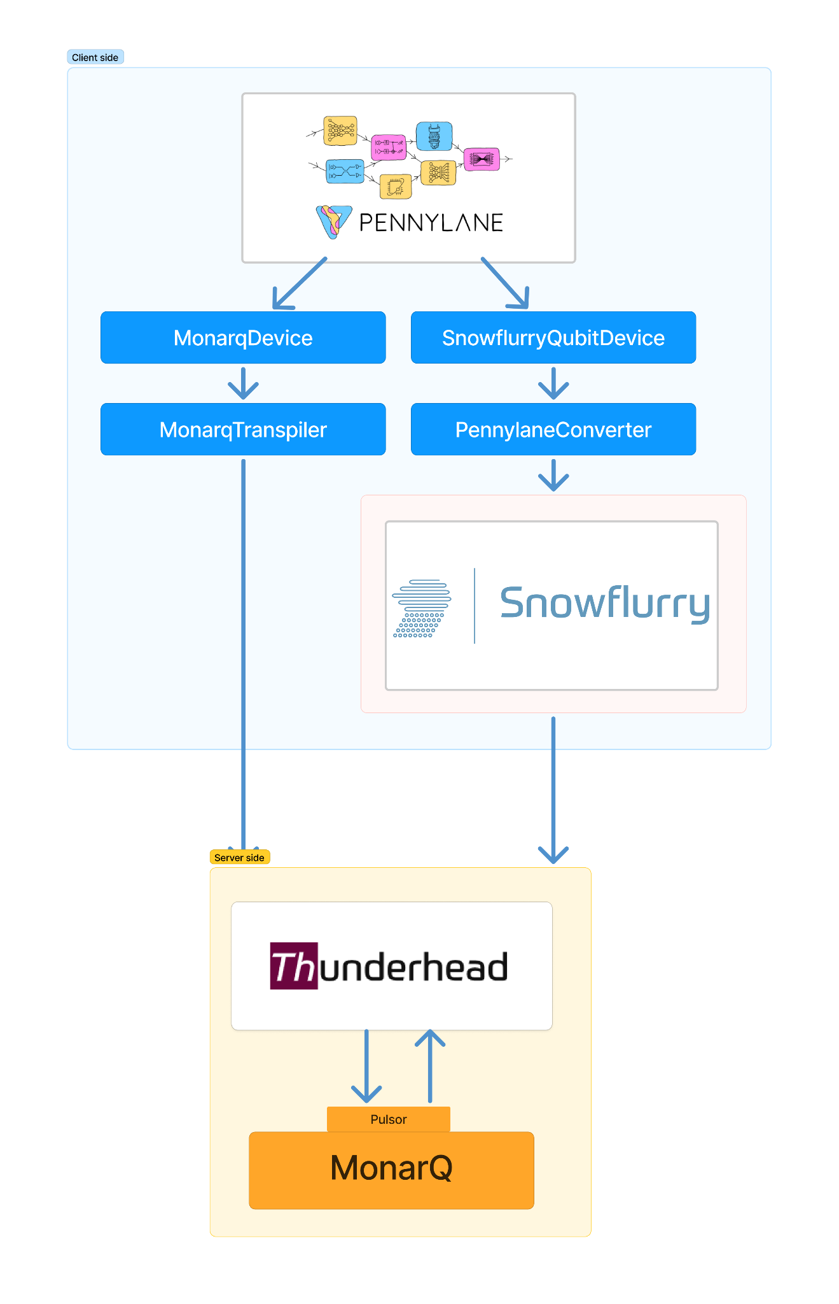
Quantum software development kits
PennyLane
  Developed in Python by Xanadu
  Interface directly with MonarQ
Snowflurry
  Developed in Julia by Anyon Systems
  Interface directly with MonarQ
Qiskit
  Developed in Python by IBM
  Qiskit-calculquebec plugin in development
Write circuits and more !

Slide 34
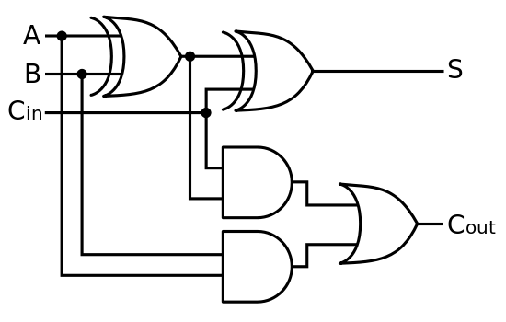
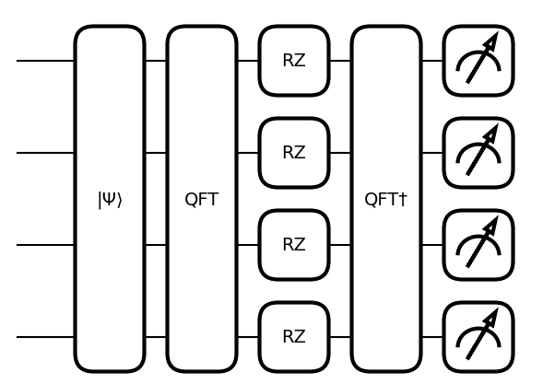
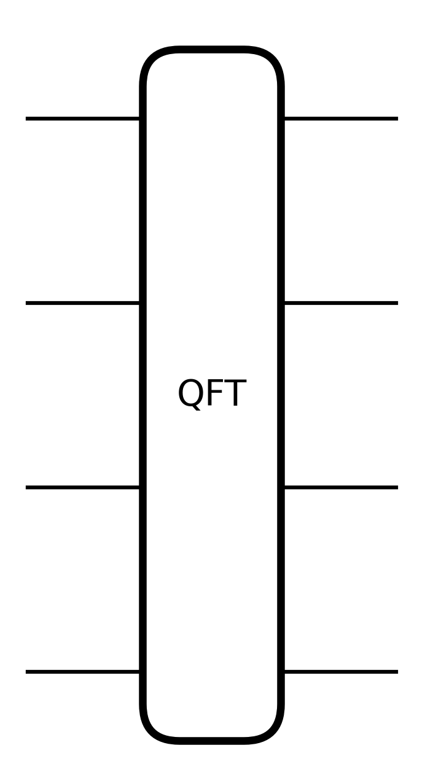
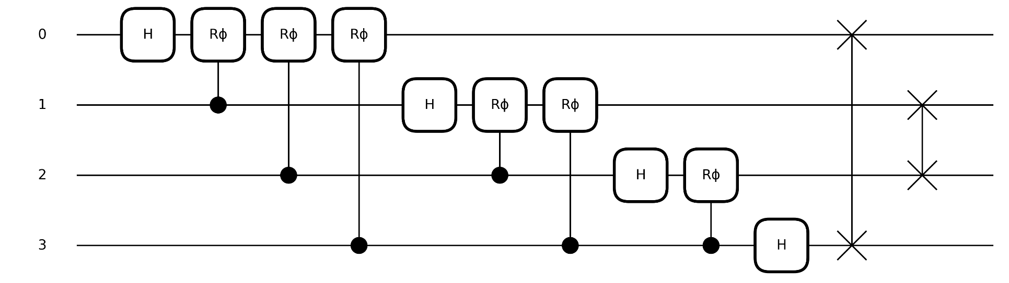
Quantum circuits
Classical computers also use circuits, but we do not generally think about these explicitly.
Classical boolean circuit for addition
Quantum circuit for addition
=

Slide 35
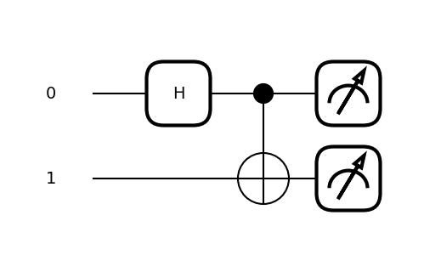
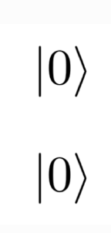
Key components of a quantum circuit
Each qubit is initialized to state 0 by default
Qubit 0
Qubit 1

Slide 36
Key components of a quantum circuit
Apply quantum gates
Qubit 0
Qubit 1

Slide 37
Key components of a quantum circuit
Measure the state of one or more qubit
Qubit 0
Qubit 1

Slide 38
Coding break
Notebook 2 :
PennyLane Basics

Slide 39
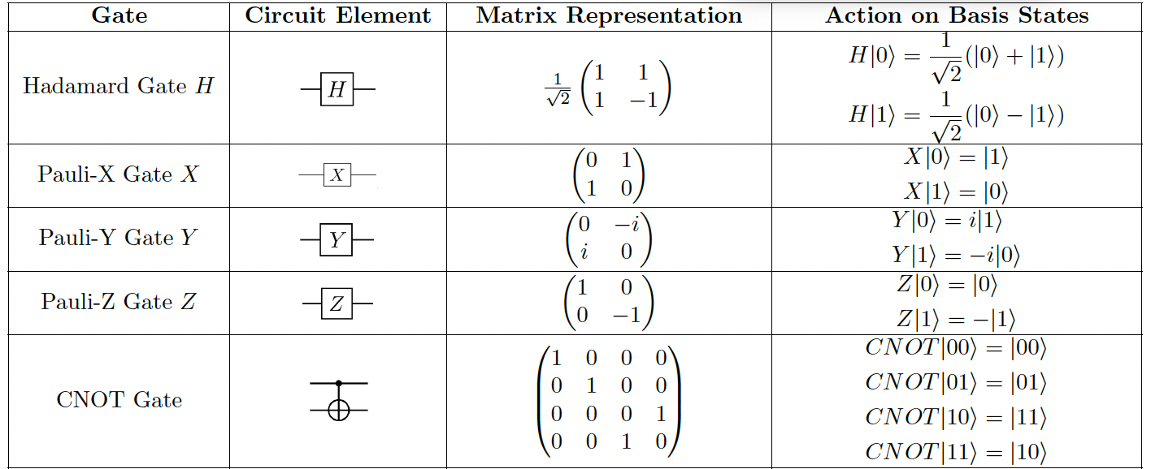
Notebook 2 cheat sheet
Quantum circuits are
composed of gates
Quantum circuits must return a measurement
(qml.state, qml.expval, qml.probs, qml.counts)
Link a circuit and a device
together with a Qnode
Qnode
Quantum function
Device
def circuit():
…
return qml.counts(0)
qml.device(...)

Slide 40
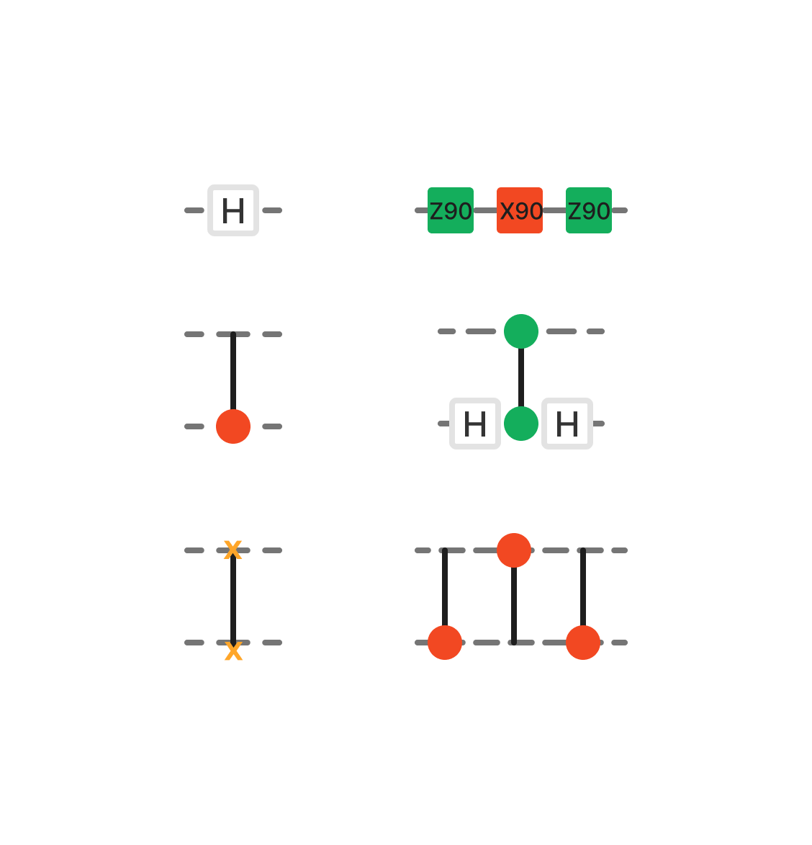
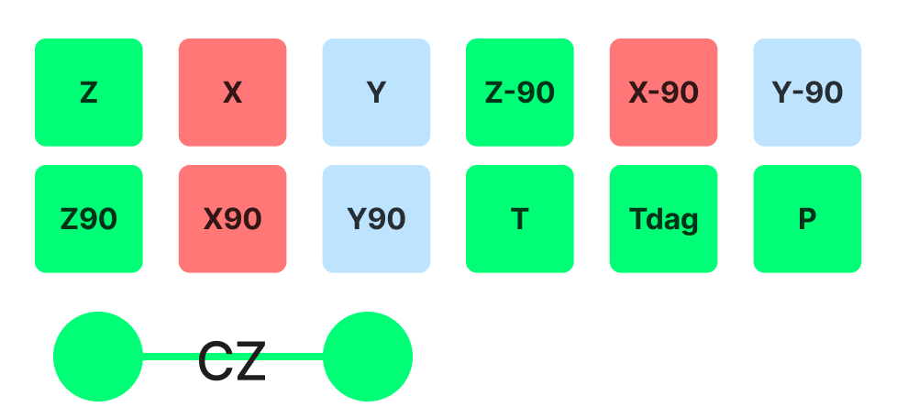
About MonarQ
⇒
MonarQ has a native set of 13 gates
Any operation can be translated to that gate set (it is universal)
Operations include : Z, X, Y, RZ90, X90, Y90, ZM90, XM90, YM90, T, adjoint(T), Phase shift and CZ
⇒
⇒
…

Slide 41

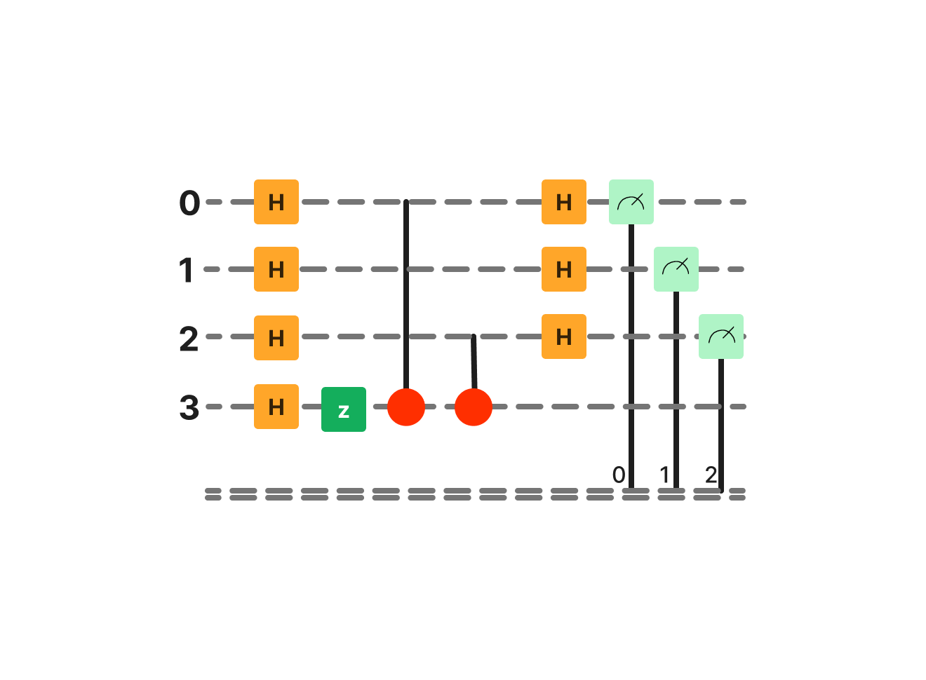
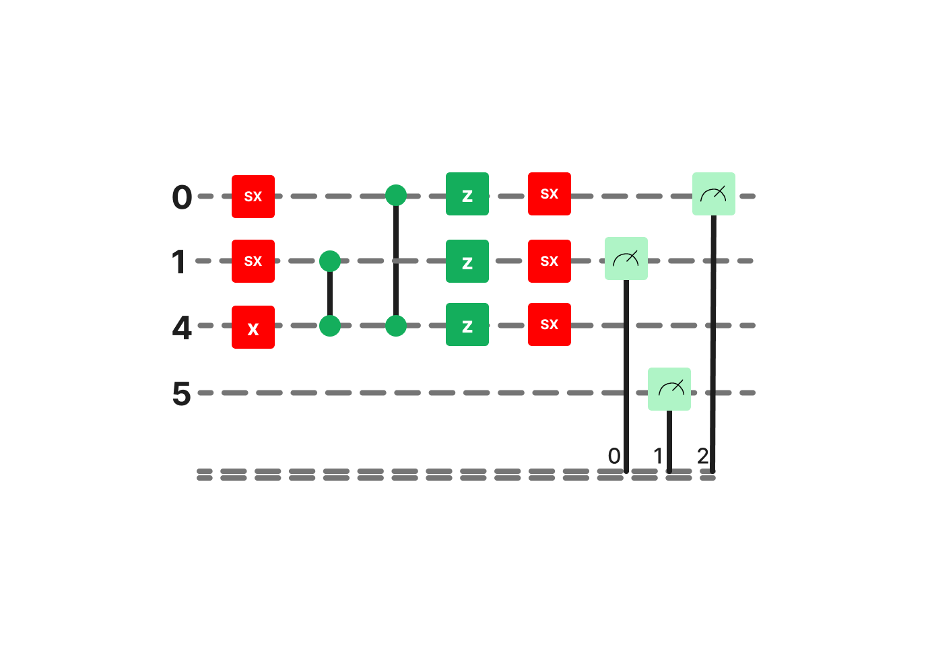
pennylane-cq plugin : A built-in transpiler for MonarQ
A transpiler makes sure a quantum circuit can run on a machine by
  Mapping the circuit’s wires to qubits in the machine
  Routing 2+ qubit operations
  Converting non-native gates*
A transpiler optimizes the circuit (making it as compact as possible) by
  Optimizing placement and routing techniques
  Cancelling trivial operations and inverses
  Finding equivalences that shorten the circuit’s size
* to gates that are implemented natively on the machine

Slide 42
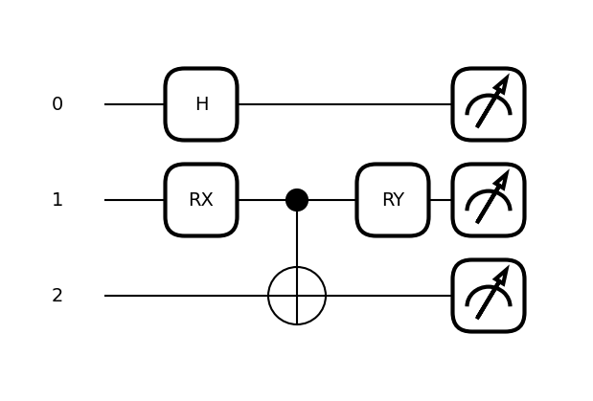
Circuit depth

Slide 43
Circuit depth

Slide 44
Circuit depth
The depth of this circuit is 3.

Slide 45
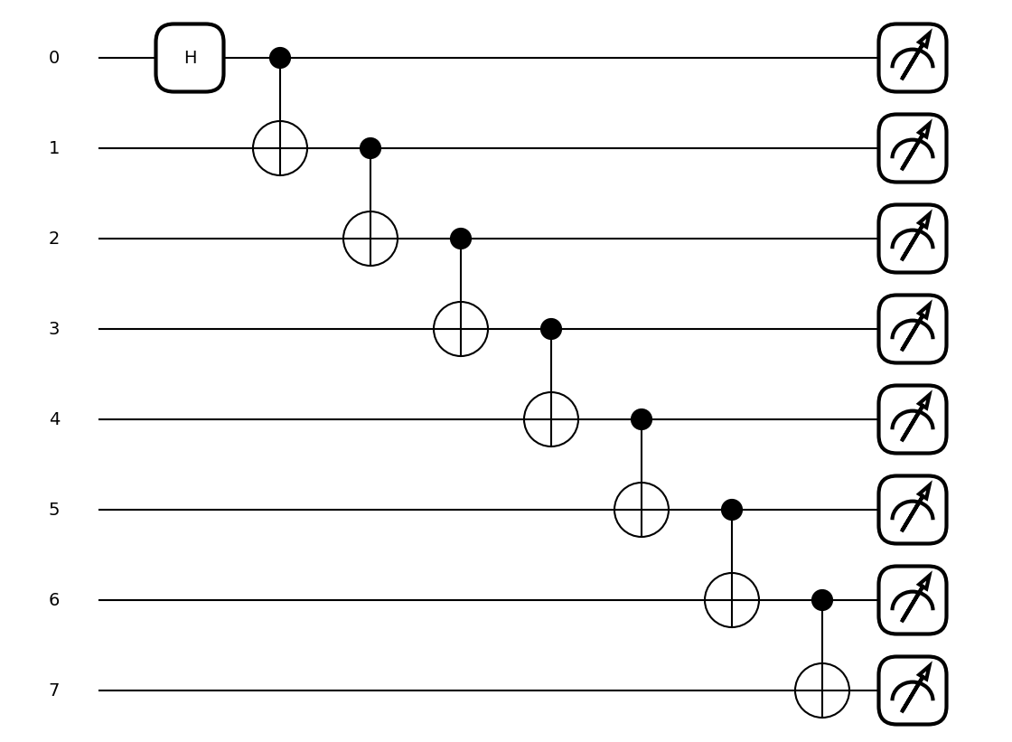
Circuit depth
What is the depth of this circuit?
Notes:
La profondeur de ce circuit est 8

Slide 46
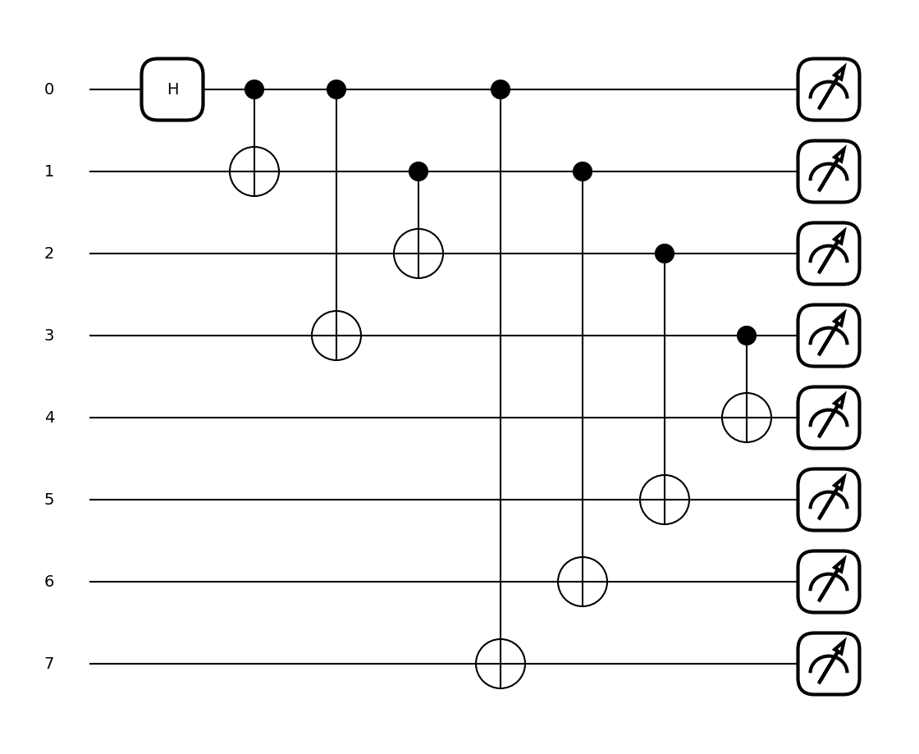
Circuit depth

Slide 47
Circuit depth

Slide 48
Circuit depth

Slide 49
Circuit depth
The depth of this circuit is 4.

Slide 50
Circuit depth

Slide 51
Case study : Double slit experiment

Slide 52
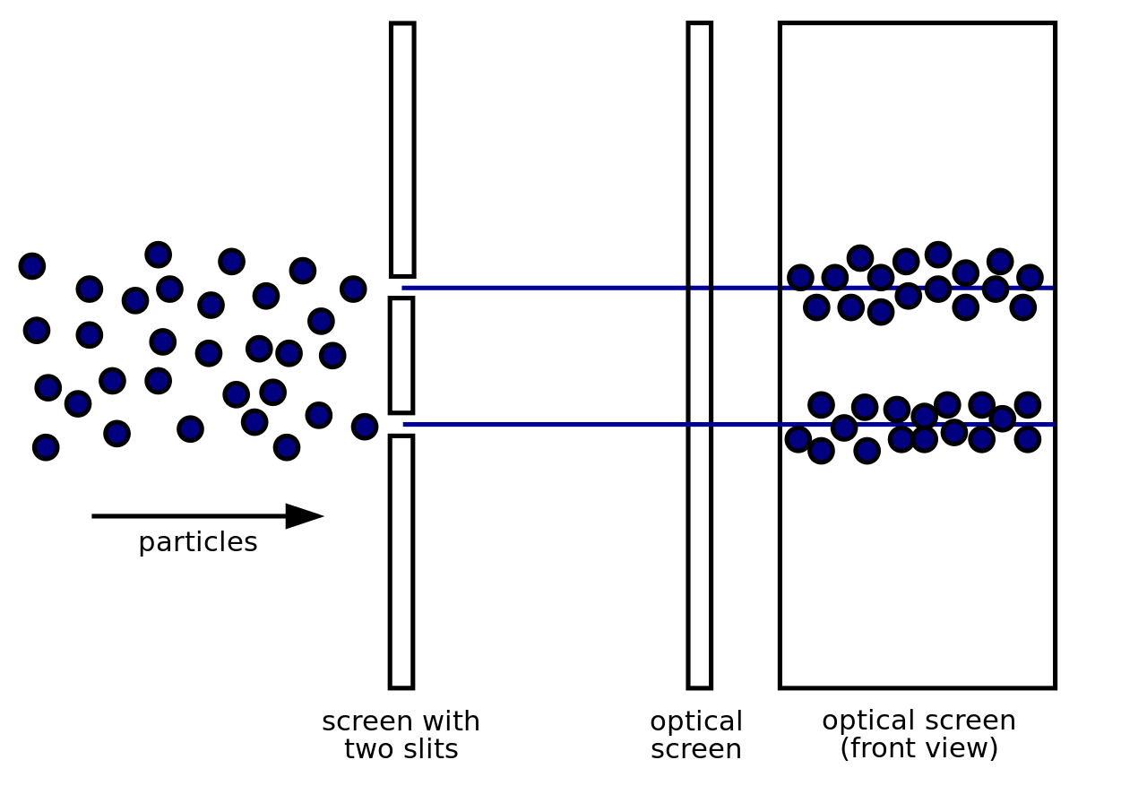
Classical particles
Notes:
Source : https://www.alloprof.qc.ca/fr/eleves/bv/sciences/l-histoire-du-modele-atomique-s1109

Slide 53
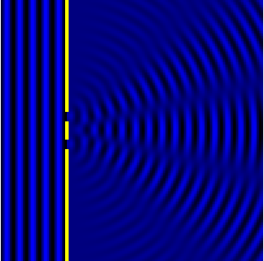

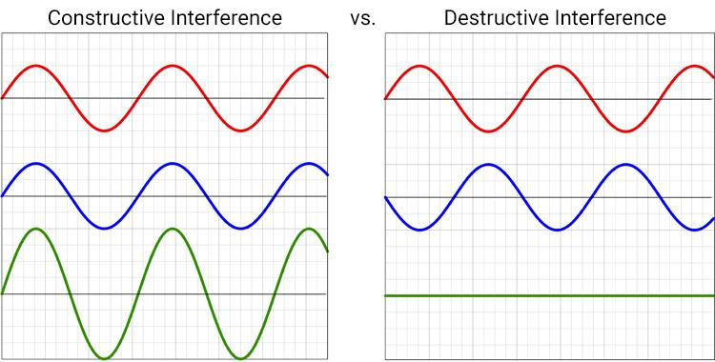

Double slit experiment : constructive and destructive interference
Constructive
+
=
Destructive
+
Probability distribution on the screen (measurements)
Evolution of the wavefunction as it crosses the two slits
=
Classically,

Slide 54
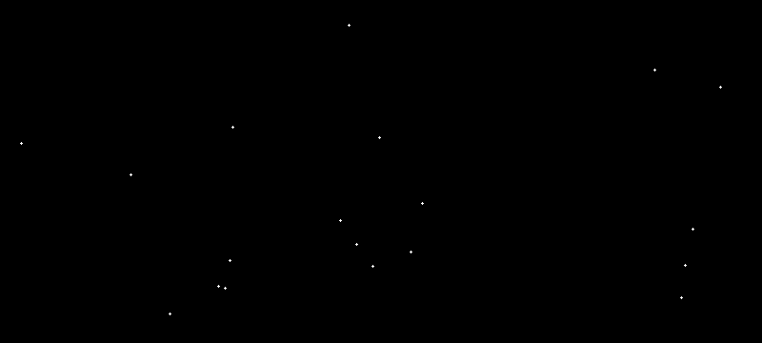
Double slit experiment with electrons : interference pattern
source : https://en.wikipedia.org/wiki/File:Wave-particle_duality.gif

Slide 55
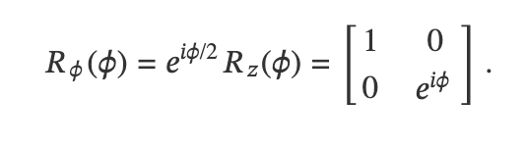
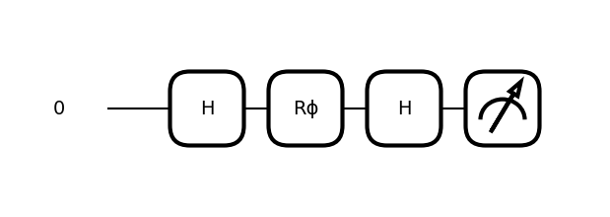
Mapping the double slit experiment to a quantum computer
Hadamard gate : puts qubit into superposition i.e the particle passes through both slits simultaneously
Phase shift gate : Applies a phase shift of phi to state |1>, simulating a relative dephasing between the paths taken i.e slit 1 or 2
Hadamard gate : Returns to computational basis so that we can measure |0> and |1>.

Slide 56
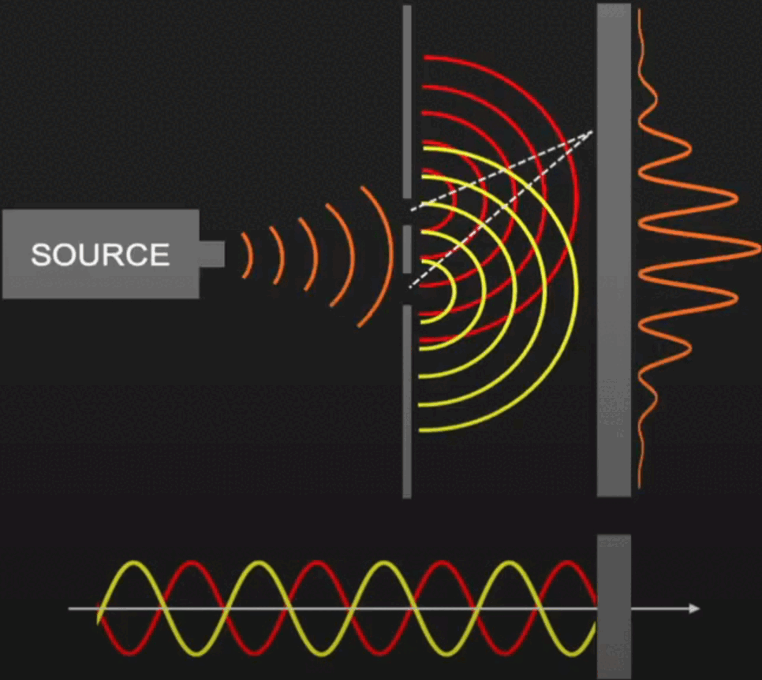
Dephasing
Phase shift gate : Applies a phase shift of phi to state |1>, simulating a relative dephasing between the paths taken i.e slit 1 or 2
Source : https://www.youtube.com/watch?v=8CCgJhsEhFQ

Slide 57
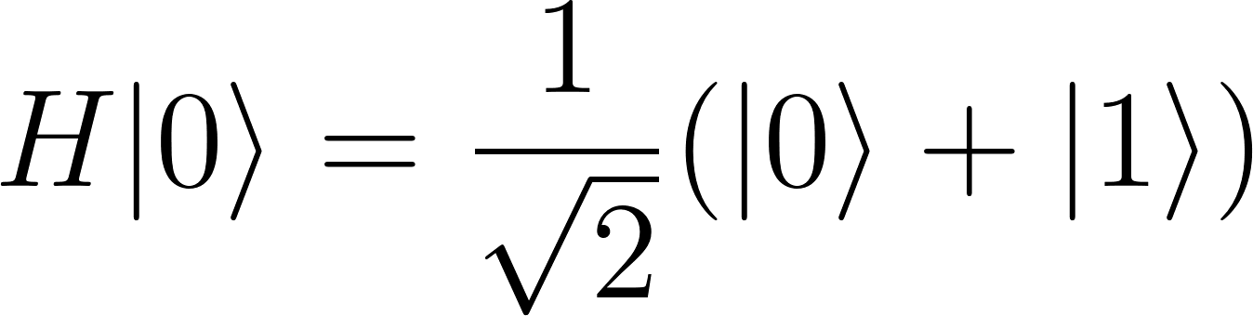
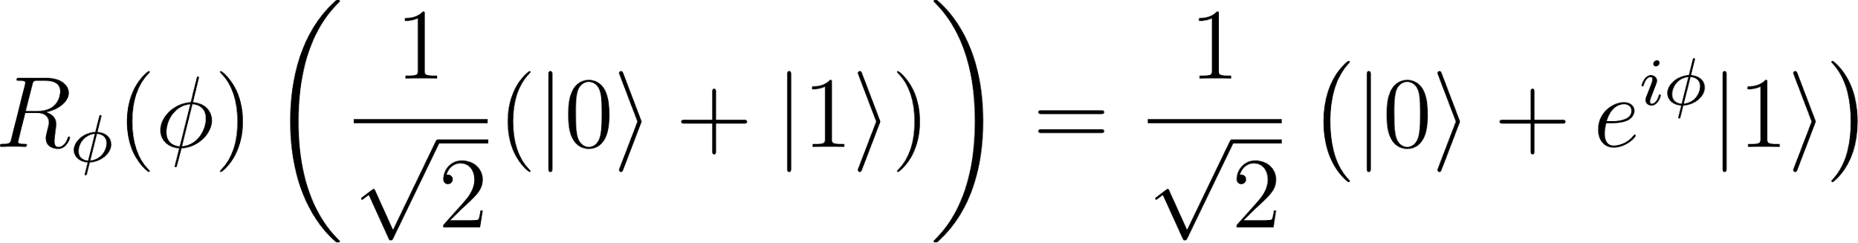
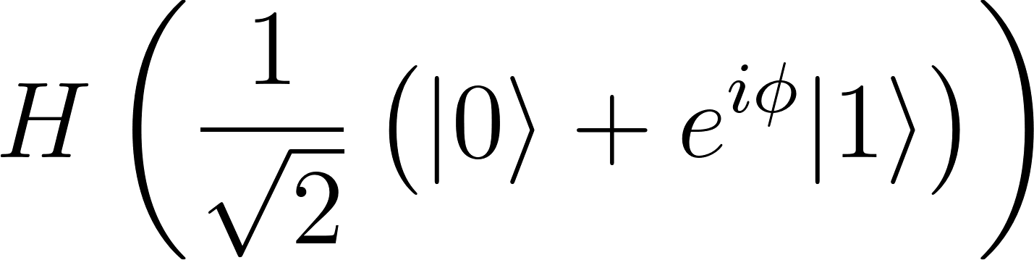
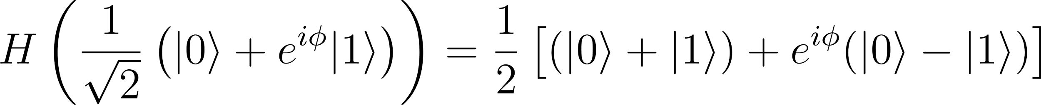
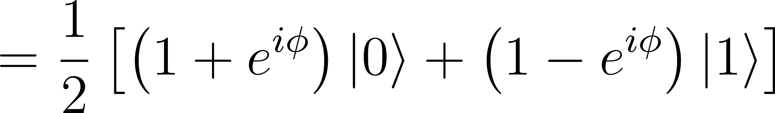
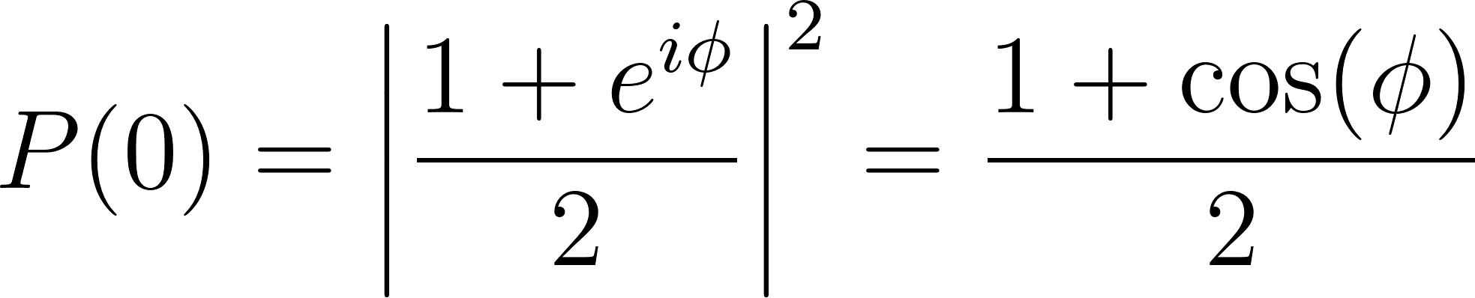


superposition
Relative dephasing
Interference
The probability of measuring |0> ie measuring particle at some point on the screen is given by
with constructive interference and destructive interference

Slide 58


Double Slit Experiment on MonarQ

Slide 59
Coding break
Notebook 3 :
Mapping the double slit experiment to MonarQ

Slide 60



To go further
Online documentation for MonarQ https://docs.alliancecan.ca/wiki/MonarQ/en
More practice in PennyLane https://pennylane.ai/codebook
Ready to use MonarQ for a research project?
  Plan an initial consultation and kick off you quantum project by filling out this form
  General questions? quantum@calculquebec.ca

Slide 61

Satisfaction survey
Please take a few minutes to fill out the satisfaction survey and share your thoughts with us!

Slide 62

Questions?
quantum@calculquebec.ca

Slide 63



Slide 64



Slide 65


Slide 66


Bits vs qubits
Just like bits, qubits are abstractions.
Ordinateur quantique
0
1
Quantum bit (qubit)
Classical bit

Slide 67
Initialize the qubit

Slide 68
Modify the state of the qubit

Slide 69
Measure the qubits
Sampling from the probability distribution,
Measure 0 (50% probability)
Measure 1 (50% probability)

